Slide 1

GRAPH THEORY AND ITS APPLICATIONS
Dr. Arti Arya
Department of Computer Science & Engineering

Slide 2

GRAPH THEORY AND ITS APPLICATIONS
HAMILTON GRAPHS
Dr. Arti Arya
Department of Computer Science & Engineering

Slide 3
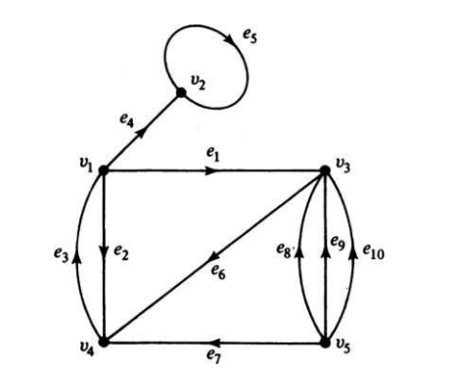

Graph Theory, Applications and Combinatorics Directed Graphs
A directed graph (or a digraph for short) G consists of a set of vertices V = {v1 , v2 , . . .}, a set of edges E = {e1 , e2 , . . .}, and a mapping Ψ that maps every edge onto some ordered pair of vertices (vi , vj ).
A digraph is also referred to as an oriented graph.
v4 is an initial vertex and v1 is terminal vertex

Slide 4
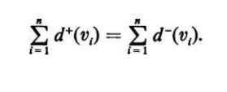
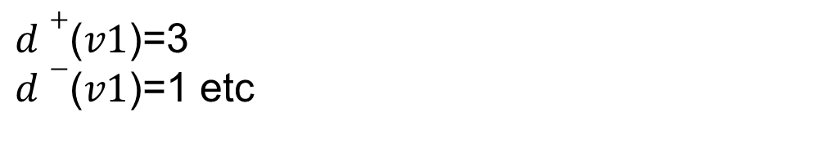
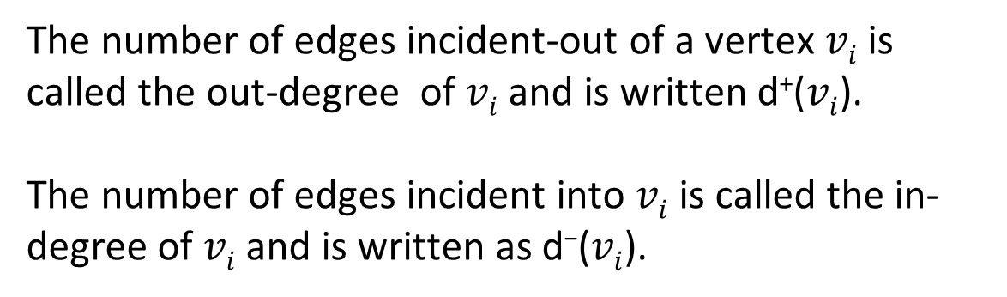

Graph Theory, Applications and Combinatorics Directed Graphs
The number of edges incident-out of a vertex $vi$is called the out-degree of $vi$ and is written d⁺($vi$).
The number of edges incident into $vi$ is called the in-degree of $vi$ and is written as d⁻($vi$).
$d+$($v1$)=3
$d−$($v1$)=1 etc
Also, in a digraph,

Slide 5
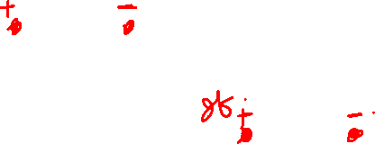
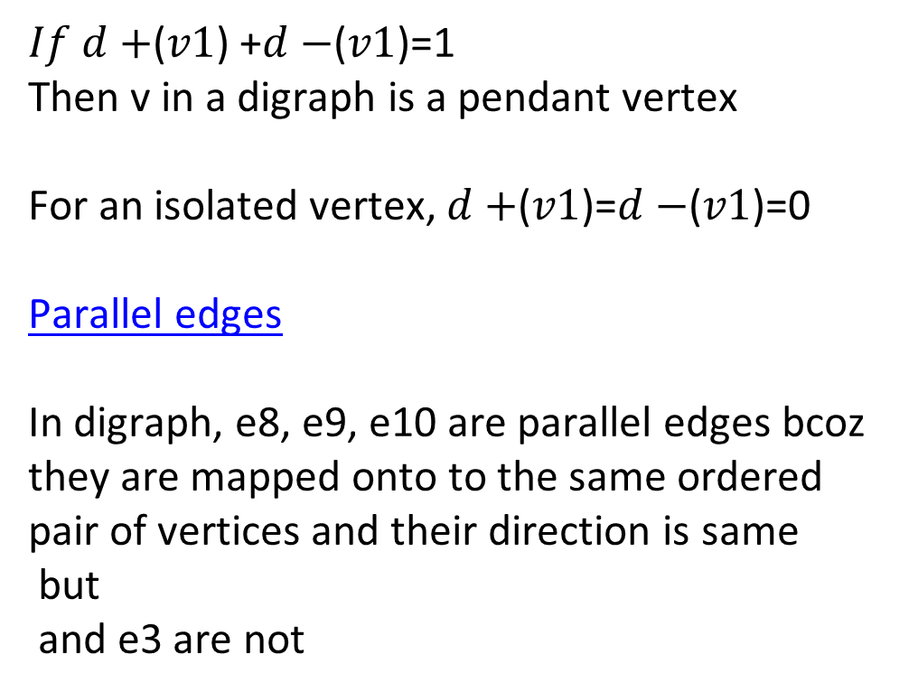
Graph Theory, Applications and Combinatorics Directed Graphs
$If d+$($v1$) +$d−$($v1$)=1
Then v in a digraph is a pendant vertex
For an isolated vertex, $d+$($v1$)=$d−$($v1$)=0
Parallel edges
In digraph, e8, e9, e10 are parallel edges bcoz they are mapped onto to the same ordered pair of vertices and their direction is same
but
and e3 are not

Slide 6





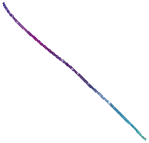





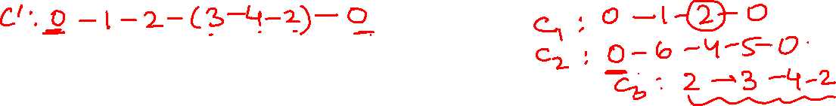











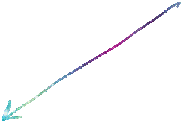












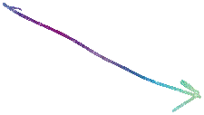














Graph Theory, Applications and Combinatorics Eulers Digraphs

Slide 7

























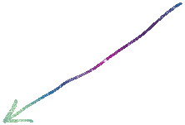


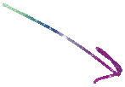







Graph Theory, Applications and Combinatorics Eulers Digraphs

Slide 8
































































Slide 9
THANK YOU
Dr. Arti Arya
Department of Computer Science &Engineering
artiarya@pes.edu

